Slide 1



ICTC Training program

Slide 2
Versioning
Version | Date de version | Auteur / Contributeurs | Nature des modifications
2.0 | 2017-03-20 | Carolandrea Guerrero Mickaël Brard Julien Jézéquel-Bréard | Diffusion initiale

Slide 3
Purchasing Management

Slide 4
Outcomes
Placing purchase orders to suppliers
Improving purchasing workflow
Managing suppliers and purchase orders
Managing supplier price lists and product availability
Understanding negotiation as a process, not only as an outcome
CC-BY-NC-SA

Slide 5
Purchasing Management
Procurement Strategies
1. Planning
2. Process
3. Optimization
Business Requirements
Supplier & Supply Market Analysis
Identification of Cost Drivers
Negotiation tactics
eSourcing and eProcurement
RFI
Vendor Selection
RFQ
Price comparison
Purchase Order
Receipt Order
Invoice match
Product & Service Profile
Approval Levels
Frame Agreement / Contractual Issues
Reception Process
Supplier Management Strategy
Supplier Evaluation &
Ranking
Service Level Agreements (SLA)
CC-BY-NC-SA

Slide 6

Purchase
Core Process
Issues
Purchases
Products / Services Managament
Supplier Management
Supplier Pricelists
Request for Quotations
Control supplier bills
Control product / service receipts
Cancel of purchase orders
Levels of approval for purchase orders
Vendor Performance
Partial Purchases Management
Replenishment
Minimum stock rule
Purchase of products based on sales
Multi-company / purchase flow
Vendor Bills
Incoming Products
Procurements exceptions
Statistics
Analyze, forecast and efficiently plan orders
CC-BY-NC-SA

Slide 7
Supply Market Analysis

Slide 8

Analyzing the Supply Market
Analyzing the supply market and managing suppliers to establish and maintain a competitive advantage.
4 steps to a supply market analysis :
Develop a commodity profile – have a clear understanding of product or service.
Supply market overview – understand the size and structure of the global market for the product or service.
Evaluation of major « players » – know the market leaders.
Study industry trends and market forces – historical prices, price drivers, the price indices, and demand fluctuations.
1
2
3
4

Slide 9



E-Sourcing / E-Procurement
eSourcing relates to the electronic procurement of products or services via the internet*.
Nowadays, you can find systems to manage from electronic data interchange (EDI) to complex operations and forms of E-Sourcing such as enterprise resource planning (ERP) systems.
Benefits
Make better decisions in terms of costs and quality
Create a repository for sourcing information
Coordinate the sourcing process
E-Sourcing Portail
Price
Quality
Entreprise (Customer)
Terms & Conditions
BIDS
* Chartered Institute of Procurement & Supply (CIPS) - https://www.cips.org

Slide 10
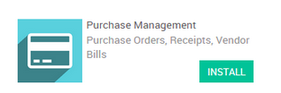
Purchase – Request for Quotation
E-Sourcing Portail
Vendor Management
Request for Quotation
Purchase Tender / Call for bids

Slide 11




Request for Quotation & Purchase Tender
You know the product
Get the best price (Relationship with suppliers)
A provider
Request for quotation (RFQ)
Customer
Purchase Order (PO)
(Place an order to the chosen supplier or you already know)
Public offers
Get the best offer (A one-off order for a product)
Purchase Tender (PT) or Call for Bids & Purchase Agreements
Multiple providers

Slide 12
Exercise - Create a Purchase Tender
Canadian Colors wants to buy new POS Cash Register for its points of sale. For this, the company will evaluate several suppliers to analyze and compare the price, quality, and performance of the equipment that are in the market.
After an in-depth analysis, these were the selected suppliers :
The company wants to create a Purchase Tender to manage multiple offers from suppliers.

Slide 13
Exercise - Create a Purchase Tender
TO DO
Record the product and suppliers
Set in the system the option « Call for tenders »
Set a Purchase Agreement or Purchase Tender for six (6) POS Cash Registers
Create a Request for Quotation and send it to suppliers to get the best price and conditions
Confirm order for the best bid
Once, you confirm the best bid, you must cancel the other bids
Done the purchase agreement
Receive the equipment
Record the supplier invoice

Slide 14
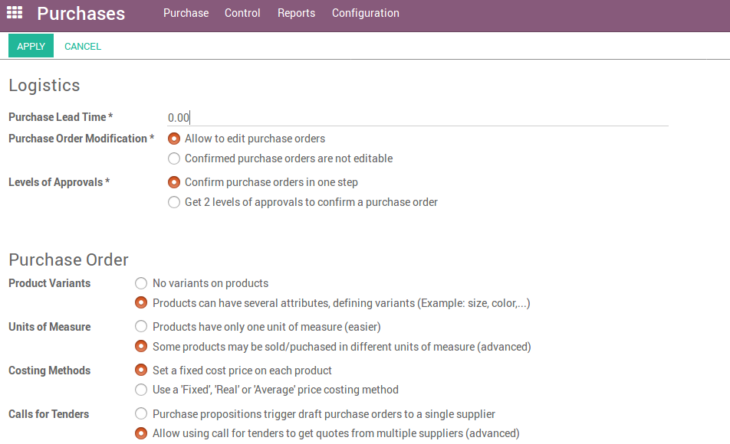
Purchase Tender Activation
Purchase Configuration Purchase Order Call for Tenders

Slide 15
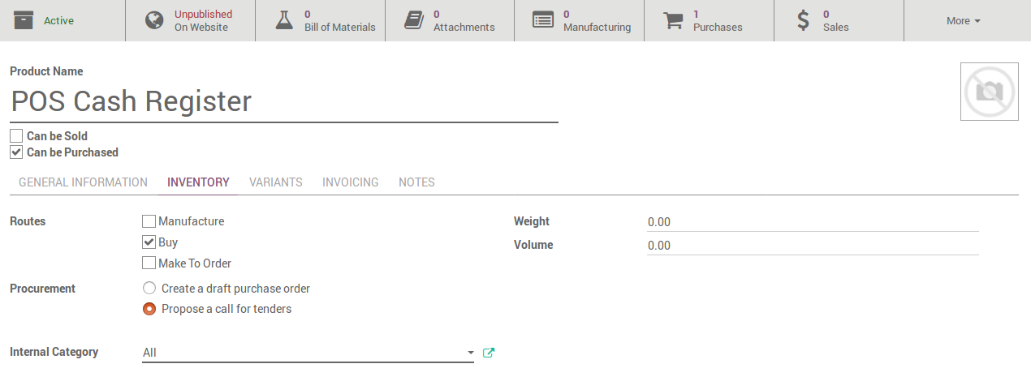
Product configuration – Call for tenders
Purchase Product

Slide 16
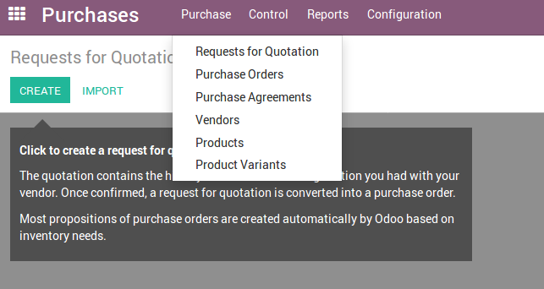
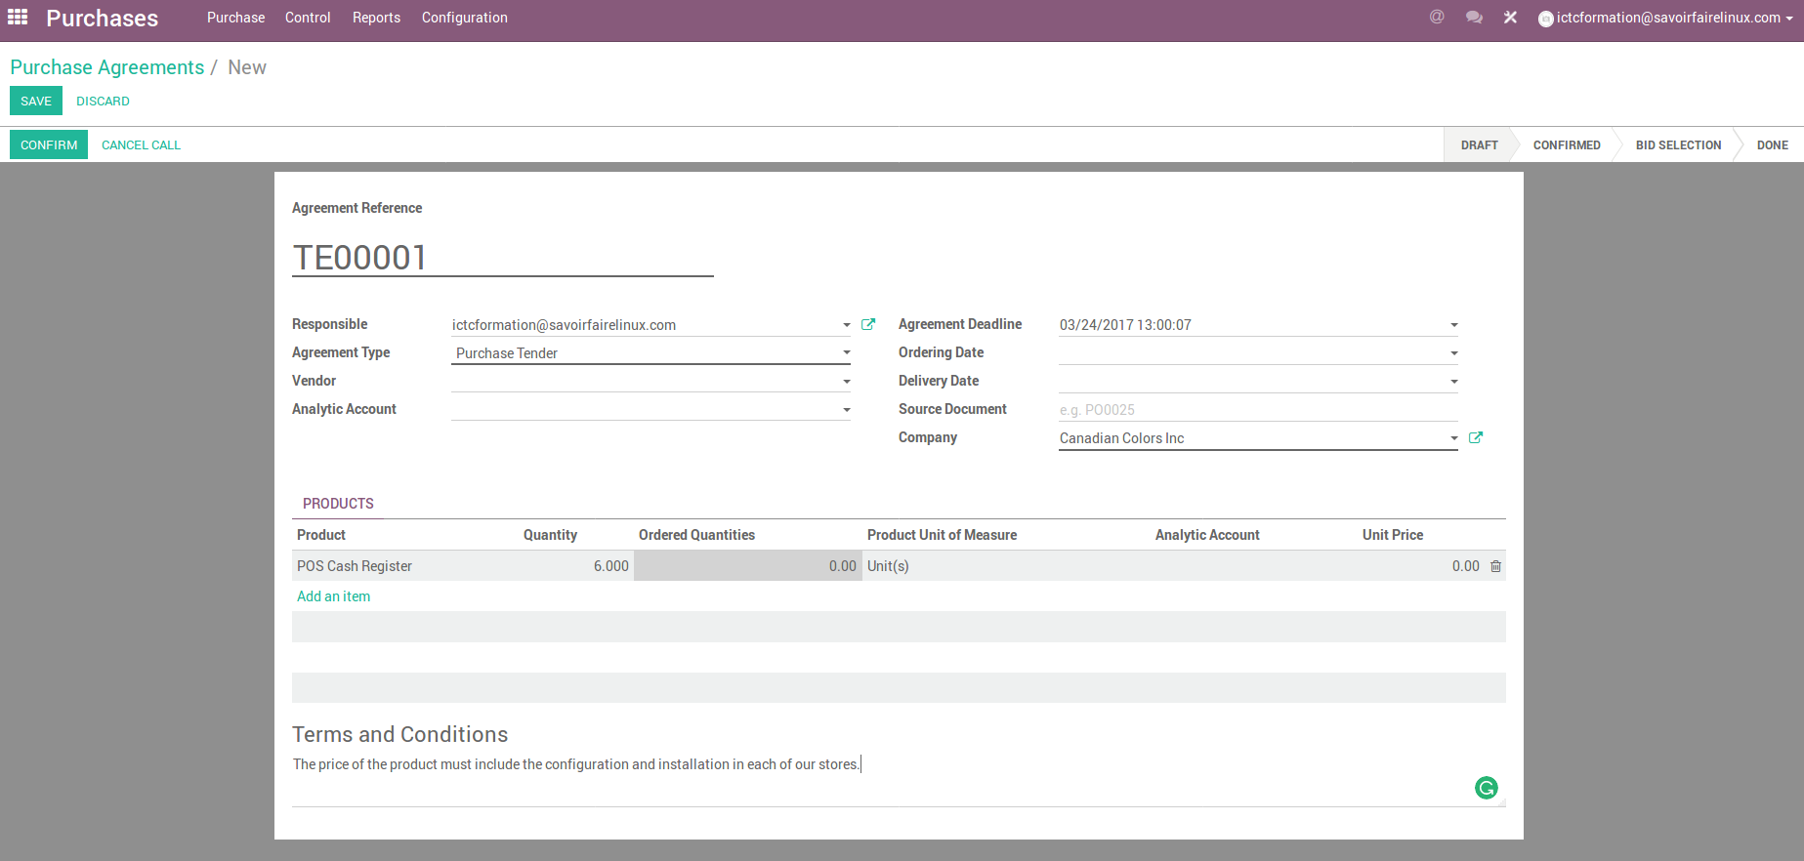
Set a Purchase Tender
Purchase Purchase Agreements

Slide 17
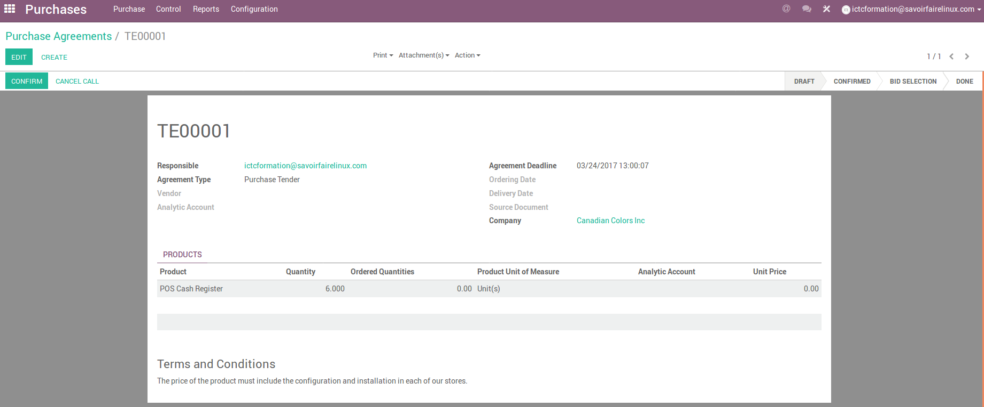

Set a Purchase Tender
1
2

Slide 18
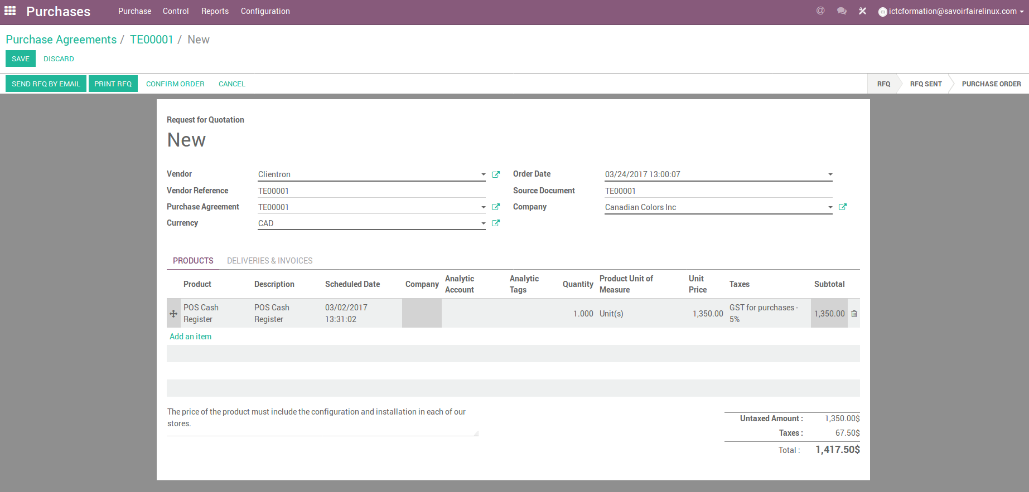
Create a Request for Quotation

Slide 19
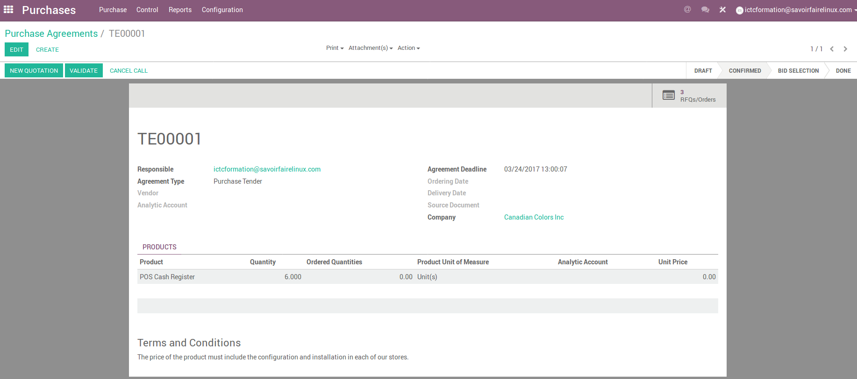
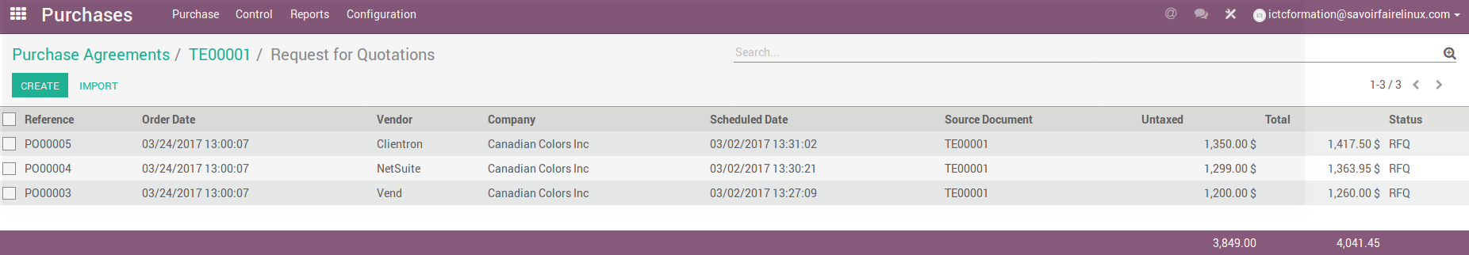
Follow-up of the Call for Offers

Slide 20
Master data

Slide 21
Exercise - Specify sales & purchase unit of mesures
Canadian Colors buys a new product in rolls and sells it in meters.
Product Information :
TO DO
According to the given information, record this product with its units of measure. Keep in mind that the units should be created under the same category of measures

Slide 22
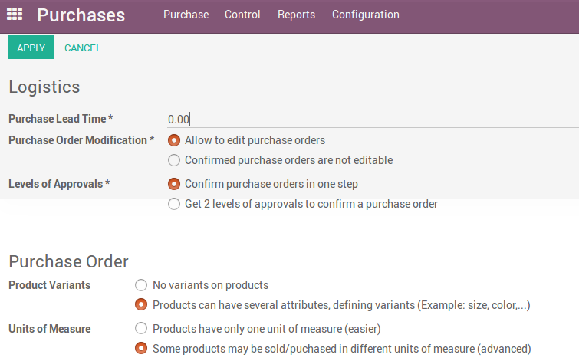
Sales & Purchase Unit of measures
Purchase Configuration Settings Unit of Mesures

Slide 23
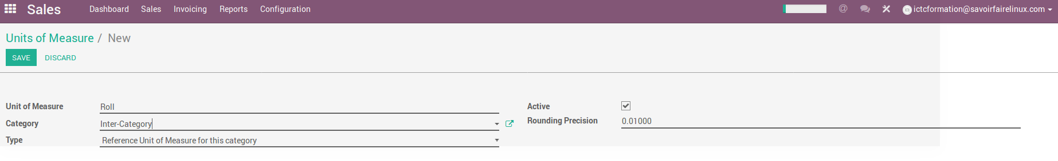
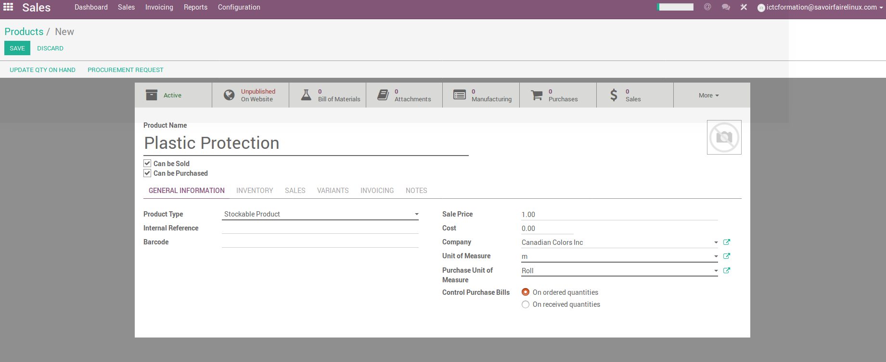
Sales & Purchase Unit of measures
Sales Configuration Products Unit of Measures
Sales Products

Slide 24
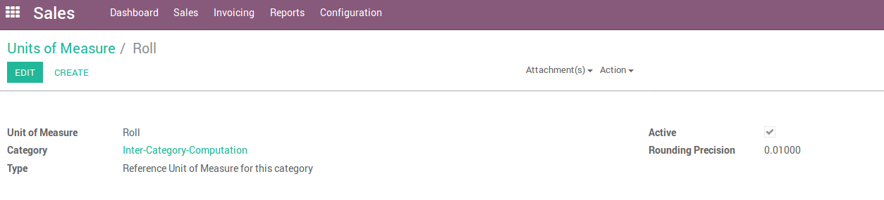
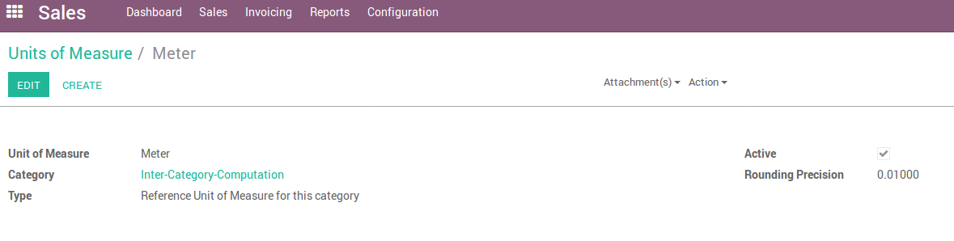
Sales & Purchase Unit of measures
Sales Configuration Products Unit of Measures
Creating the « Roll » measure
1
Creating the « Meter » measure
Keep in mind that the units should be created under the same category of measures.

Slide 25
Exercise - Several suppliers on a product
Canadian Colors buys the last product from several suppliers. The company wants to record them because the price or this product varies according to the availability of inventory of each supplier.
Supplier Information :
TO DO
According to the given information, record suppliers for this product.

Slide 26
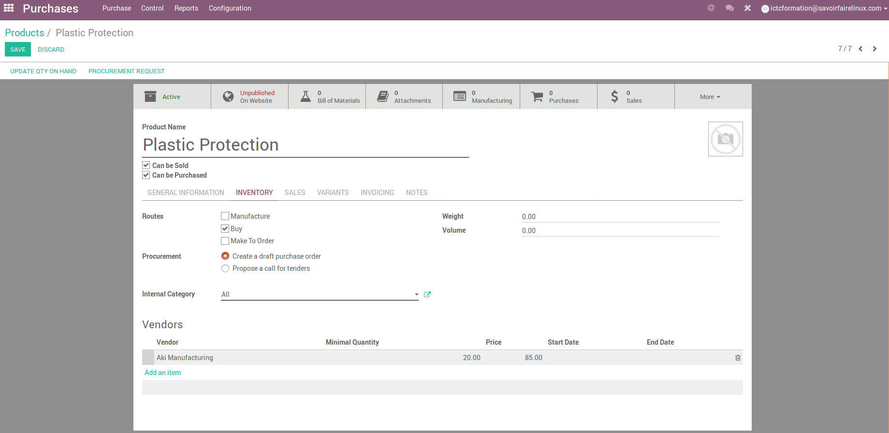
Several suppliers on a product
Purchase Products

Slide 27
Purchase Management

Slide 28
Purchasing Process
In Odoo, a purchase order can be created directly, but can also be the result of a Request for Quotation or of a Purchase Tender. Therefore, every purchase made in Odoo has a Purchase Order.
The Purchase Order will generate an invoice and depending on the contract with your supplier, you will be required to pay the invoice before or after delivery.
Quotation
Purchasing
1
Quotation
Purchasing
Product receipt
Invoice
Payment
1
2
Quotation
Purchasing
Payment
Invoice
Product receipt

Slide 29
Case Study - Purchase of raw materials
Canadian Colors sells complementary products like paint brushes among others, which are bought from local suppliers. These products have a high demand and are only sold directly in stores and through the website.
Below some factors that the company considers for the purchase:
Canadian Colors buys the paint brushes separately and sells them in a set of 4 units.
Although the set is supplied by warehouses, each store holds a minimum of units in stock.
For purchases over 3.000$CAD, the company has established two (2) levels of approvals before sending a purchase order to its suppliers.
TO DO
Before creating a purchase order, you have to set up the level of approval of purchase orders.

Slide 30
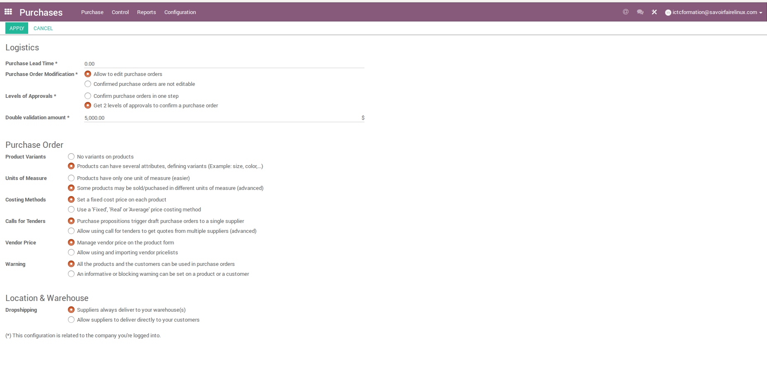
Purchase – Setting level of approvals
Settings Purchases Levels of approvals

Slide 31
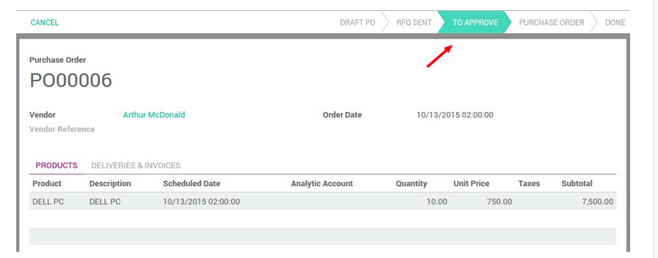
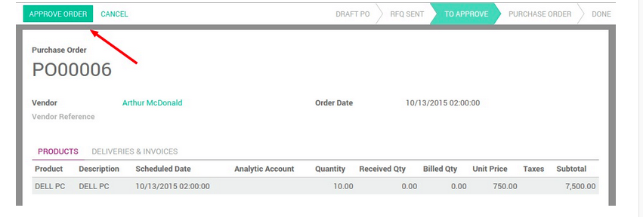
Purchase – Setting level of approvals
User Profile who makes the purchase
User profile who approves the purchase

Slide 32
Exercise : Setting a product as a set of components
45 min
TO DO
Record each brush as an individual product for purchase and inventory control
Create the set of brushes as a product and its components (see e.g. « Painting Scraper Set » product)
Record « Blick Art Materials » as the supplier for this product (fill out the basic information).
Add manually the vendor information to each component of the bill of materials that you had created before. Add extra information such as the price and the eventual minimum quantity required.
Set Components

Slide 33
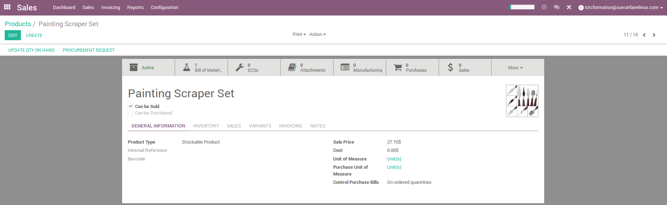
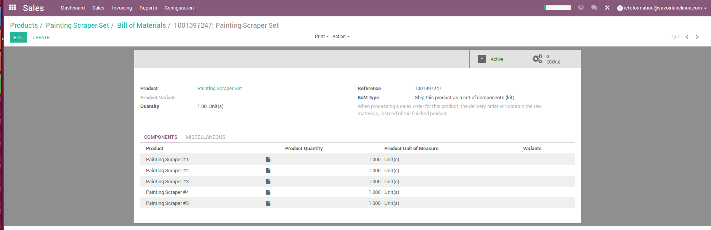
Purchase – Setting a set
1

Slide 34
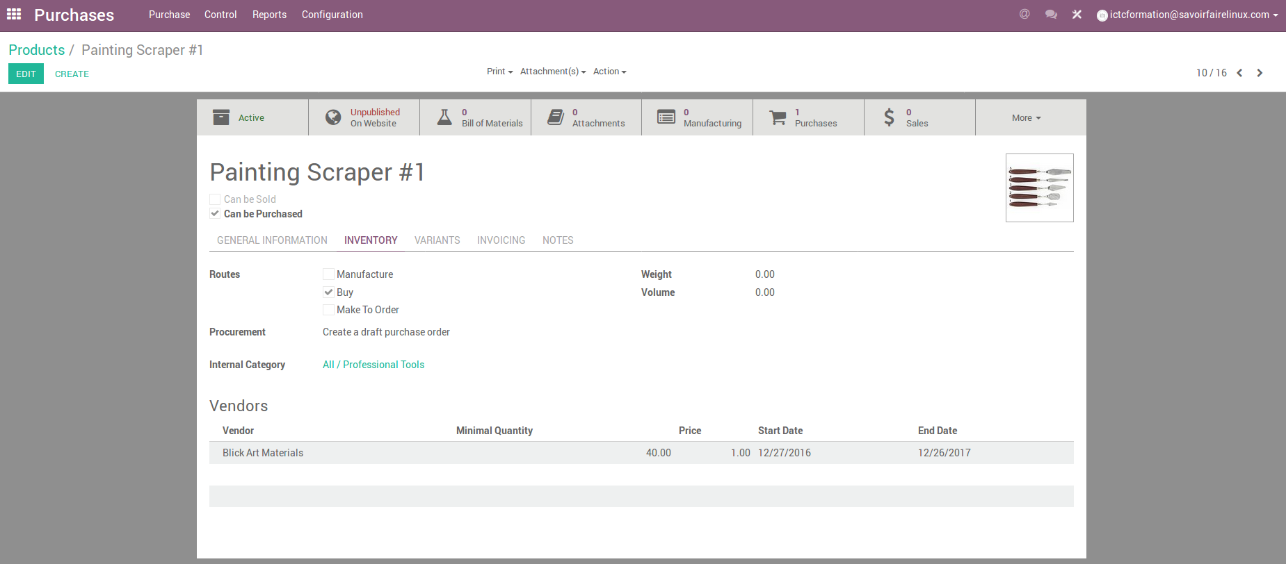
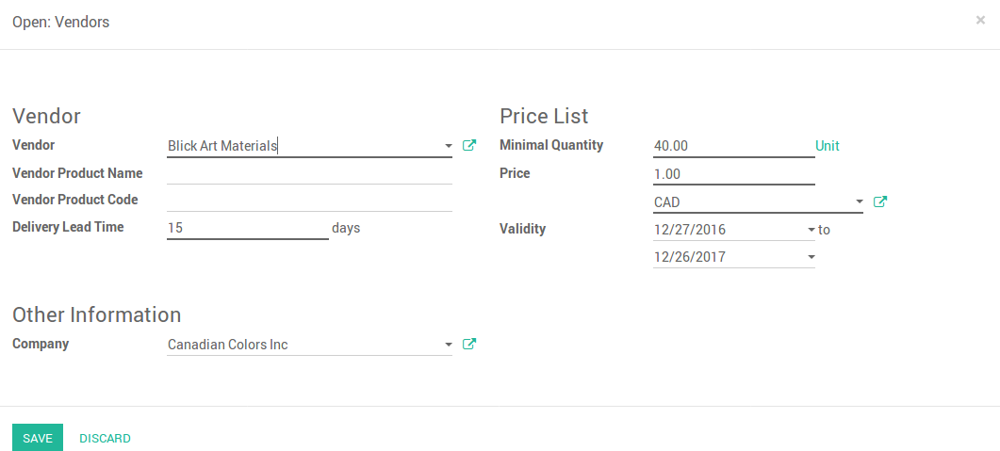
Purchase – Create a vendor

Slide 35
Exercise : Create a purchase order
40 min
The Canadian Colors stores do not have enough inventory of the set of brushes, therefore it must make a purchase of the components of the set to ensure availability of this product.
TO DO
Make a purchase order to buy 300 units of each brush model, and send it by email to the supplier
The supplier will make partial delivery of the product, therefore, you will make three (3) partial receipts of the merchandise purchased. Each partail receipt will be 100 units
When you will receive all products, invoice the purchase order

Slide 36
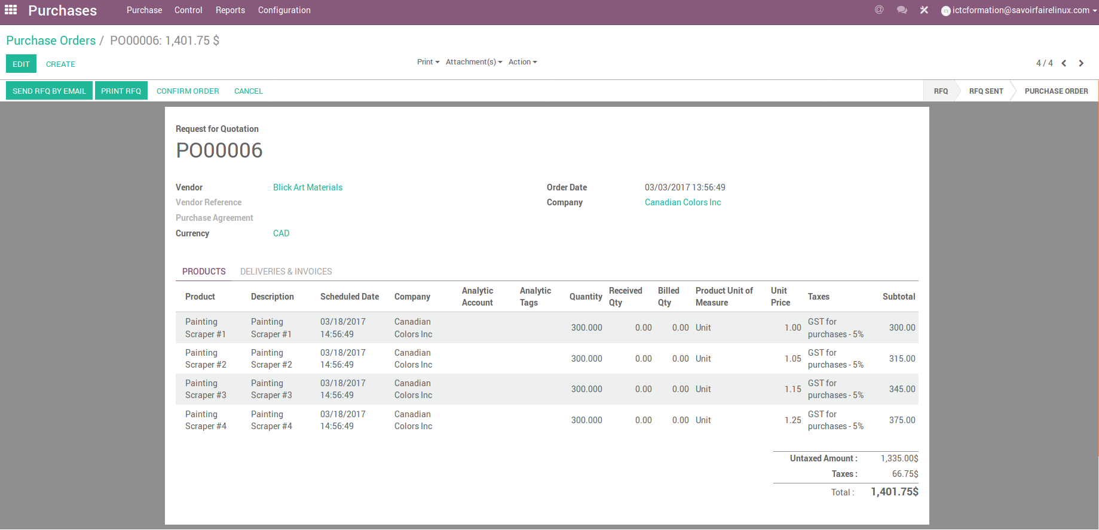
Purchase Order
1

Slide 37
Control receptions

Slide 38
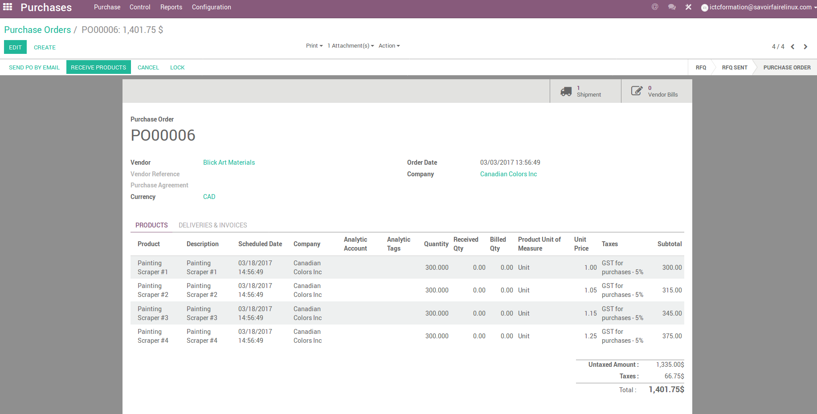
Purchase – Receive products

Slide 39
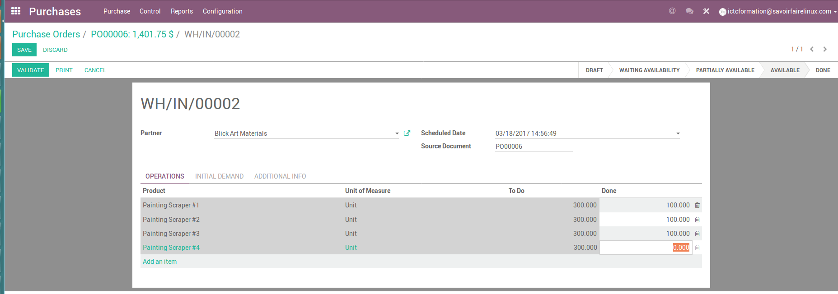
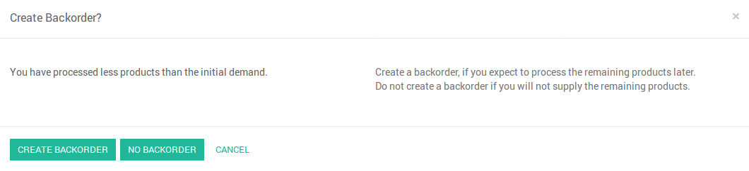
Purchase – Partial product reception
1

Slide 40
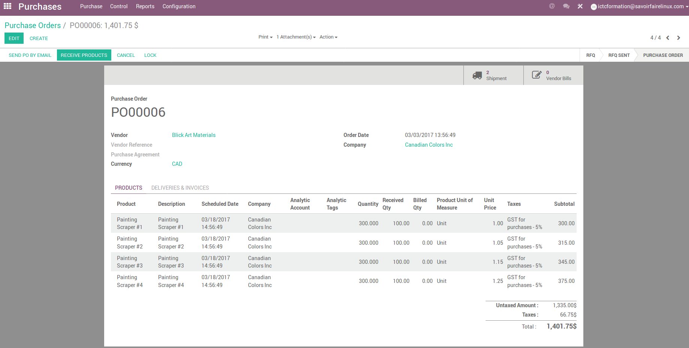
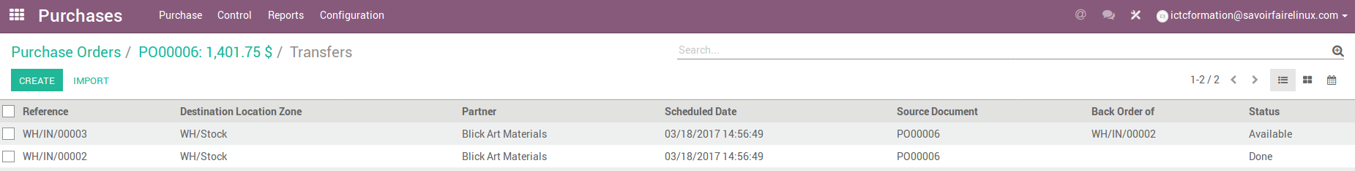
Purchase – Partial product reception

Slide 41
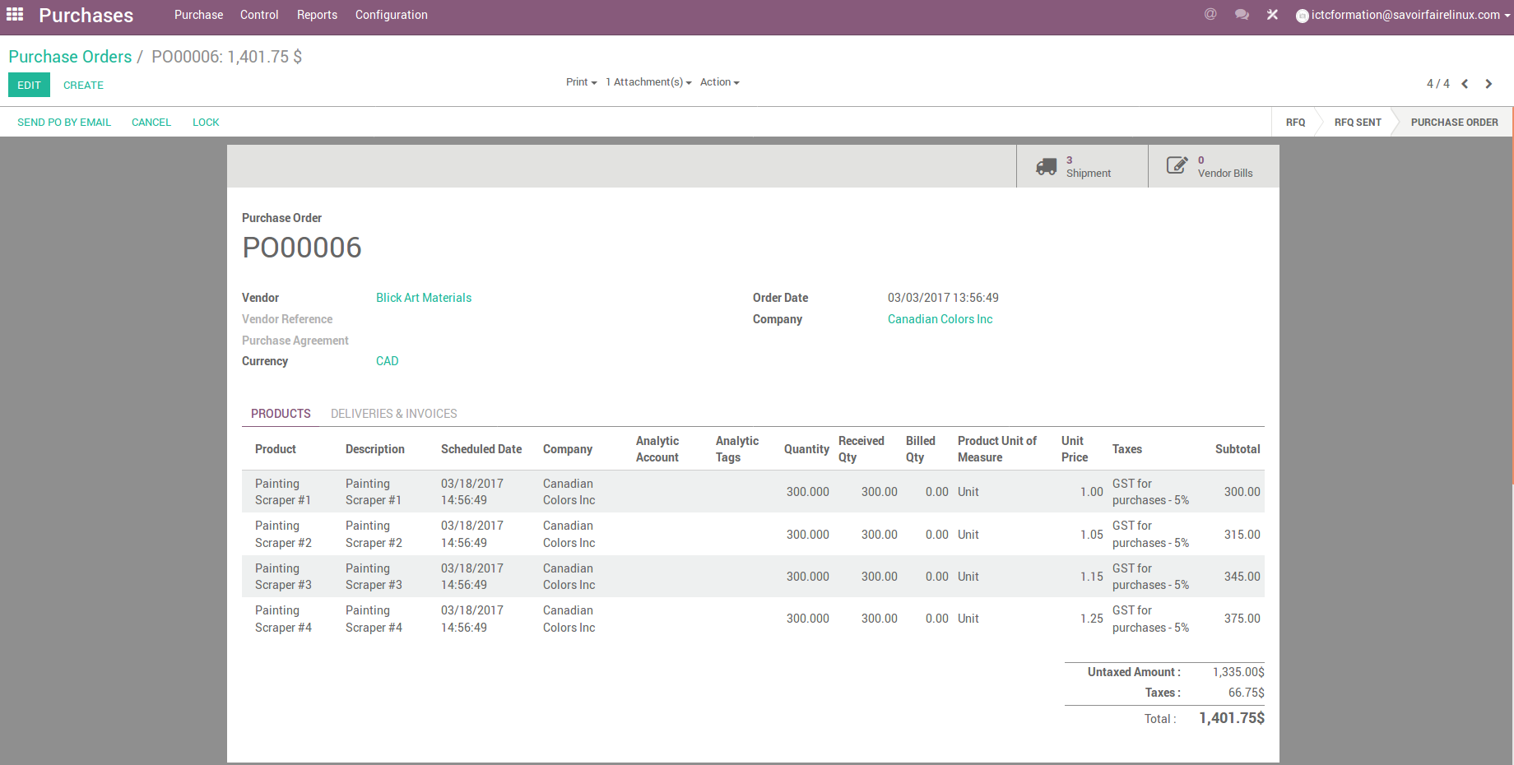
Purchase – Invoice the purchase order

Slide 42
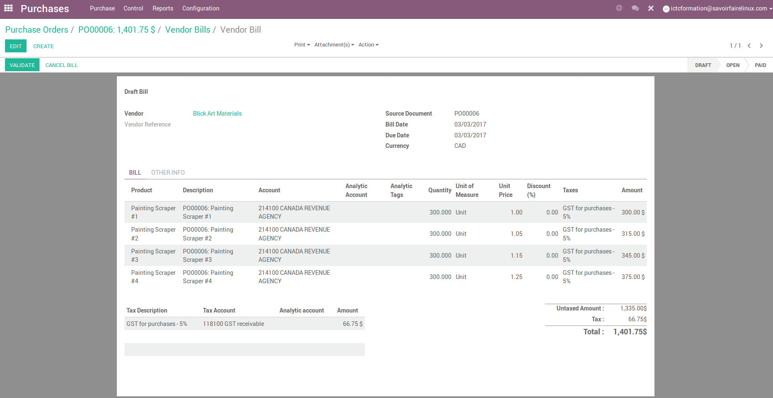
Purchase – Invoice the purchase order

Slide 43
PO linked to Analytical Accounts

Slide 44
Exercise : Create a purchase order linked to the analytical account
45 min
Store remodeling project :
Canadian Colors wants to remodel its stores in order to increase their ability to display and update the access control software of its employees. To do this, Canadian Colors created a project to manage activities and expenses associated.
At the moment, Canadian Colors would like to relate the purchase of access control software, which costs 60.000$CAN with consultation.
TO DO
In settings of the accounting module, enable analytical accounting and create an analytical account (e.g. register « Store remodeling project » as an analytical account).
Create & confirm a purchase order linked to the analytical account. You have to create « Access Control Software » as a product and « SFL Montreal » as a supplier.
Register the invoice that will be booked in the analytical account
Register the payment and check the cost in the analytical account

Slide 45
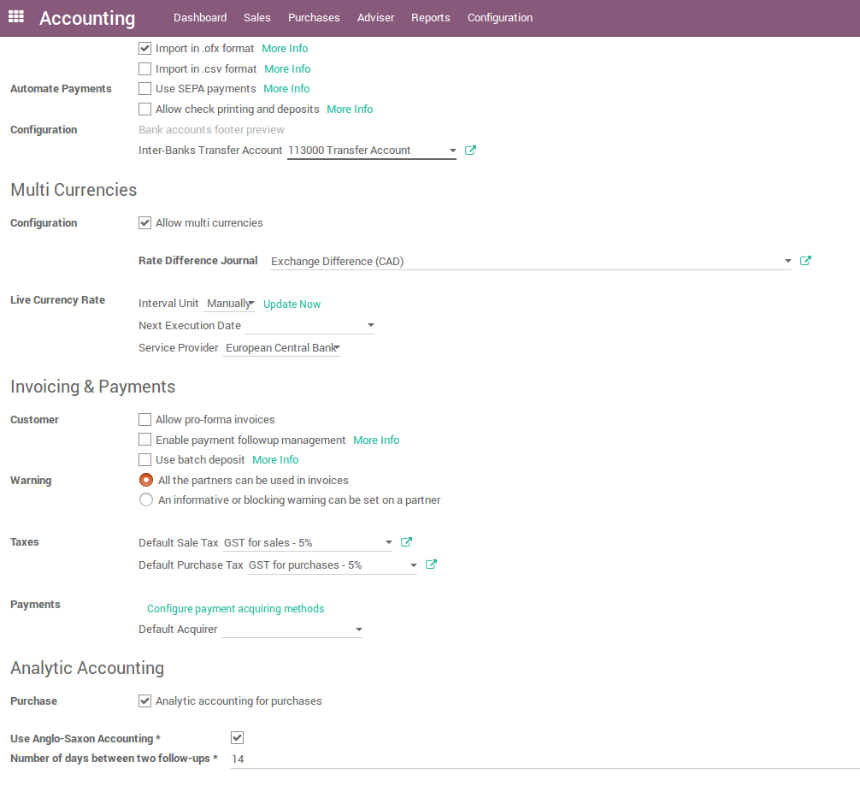
Purchase – Activate Analytic accounting
Settings Analytic Accounting Purchase

Slide 46
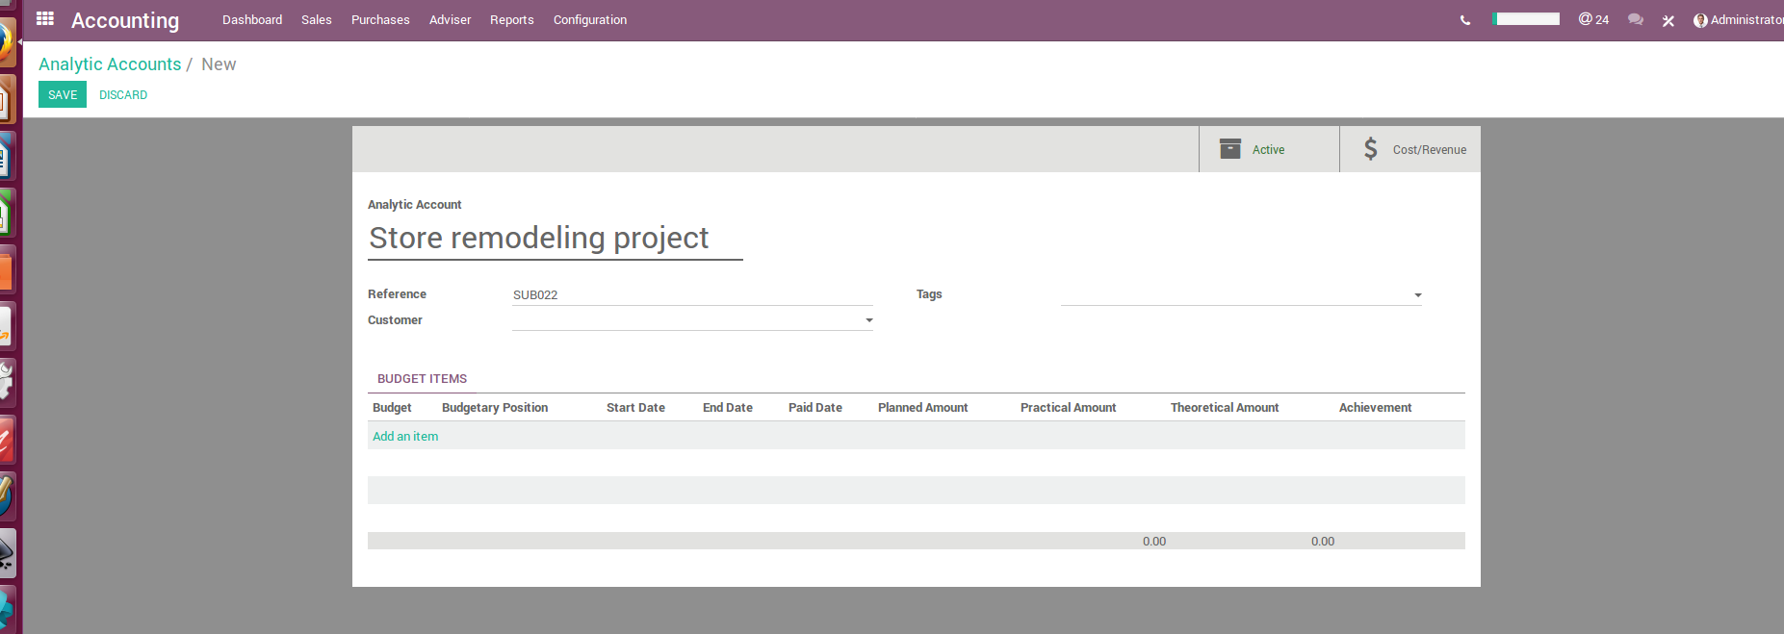
Purchase – Create an Analytical account
Accounting Configuration Analytic Accounts

Slide 47
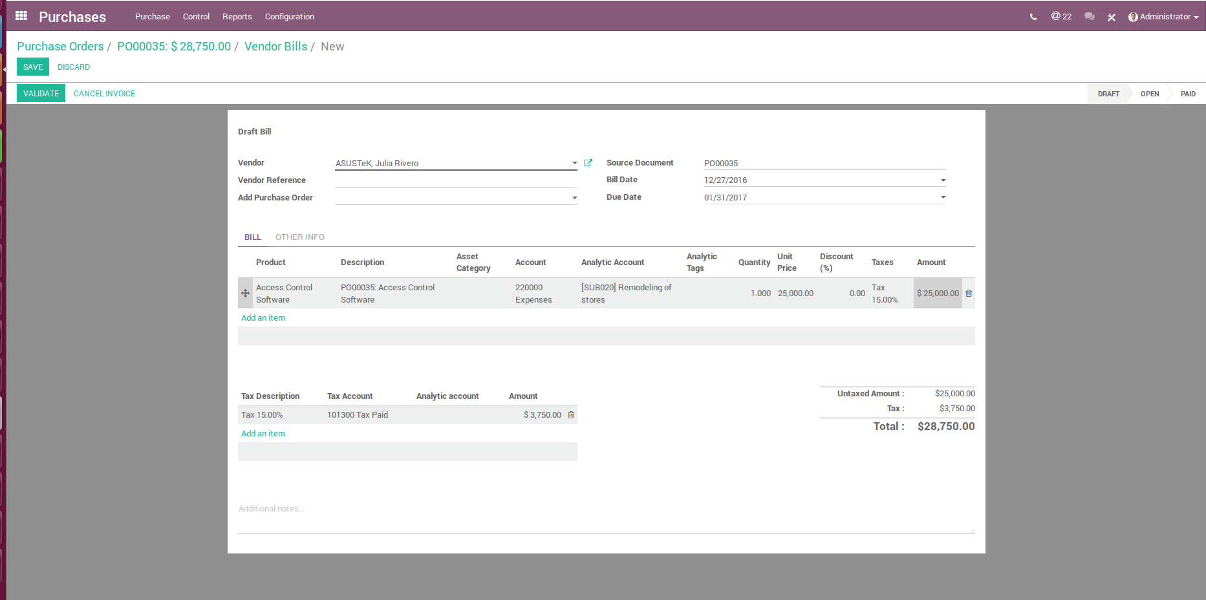
Purchase – Vendor Price books in the analytical account

Slide 48
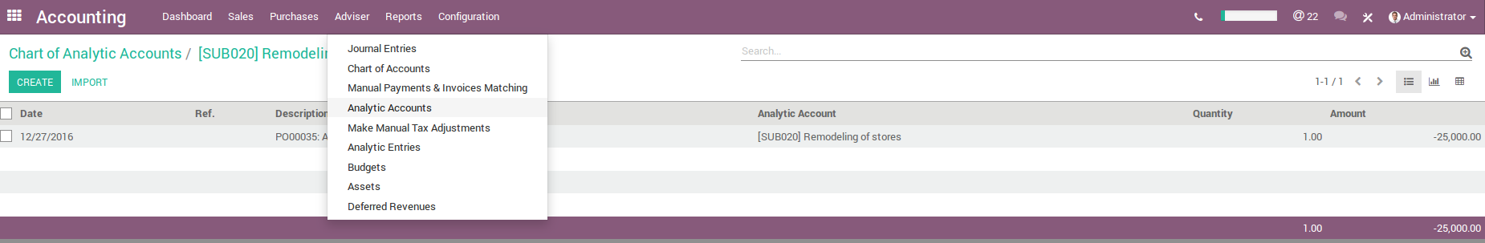
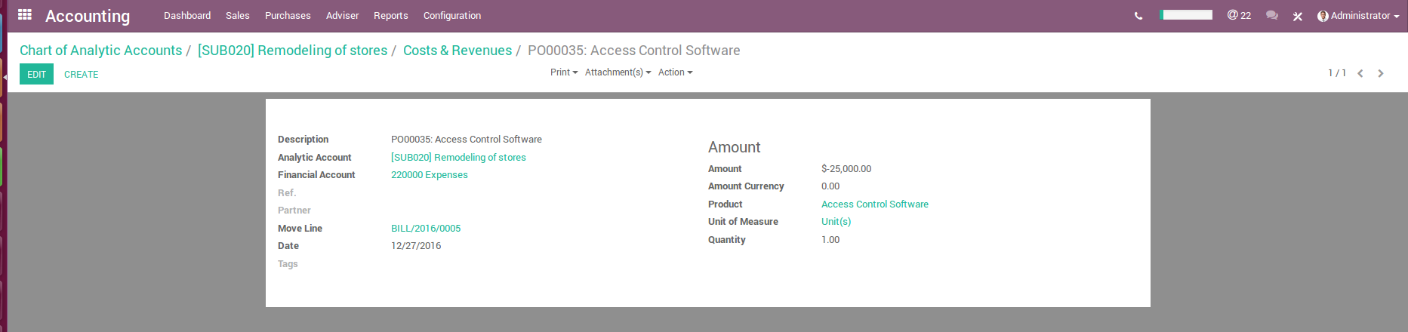
Purchase – Vendor Price books in the analytical account

Slide 49
Analyzing performance

Slide 50
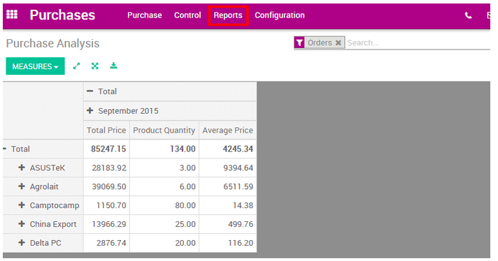
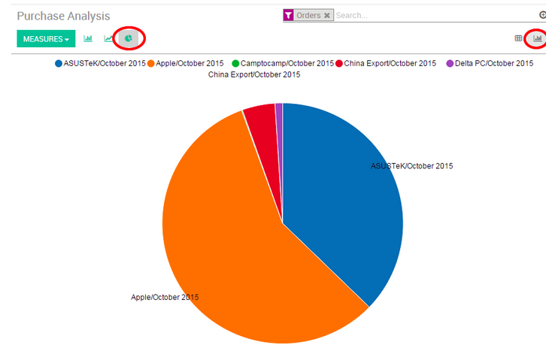
Purchase – Analyze the performance of vendors
Customize reports - All purchase orders by total price, product quantity and average price for the each month and for each supplier.

Slide 51
Contributions
Le présent document a été rédigé et émis par l’équipe de consultants fonctionnels Odoo ERP de Savoir-Faire Linux :
Carolandrea Guerrero
Mickaël Brard
Marc Lijour
Julien Jézéquel-Bréard
Bruno Joliveau
Quentin Lavallée
Adriana Ierfino
Guillaume Lot
Vous pouvez récupérer les documents de formation, les utiliser et modifier (dans les limites des conditions prévues par la licence CC-BY-NC-SA), depuis l’url suivante : https://github.com/savoirfairelinux/training-odoo

Slide 52

IT Management Solutions
LICENCE : CC-BY-NC-SA

